Slide 1
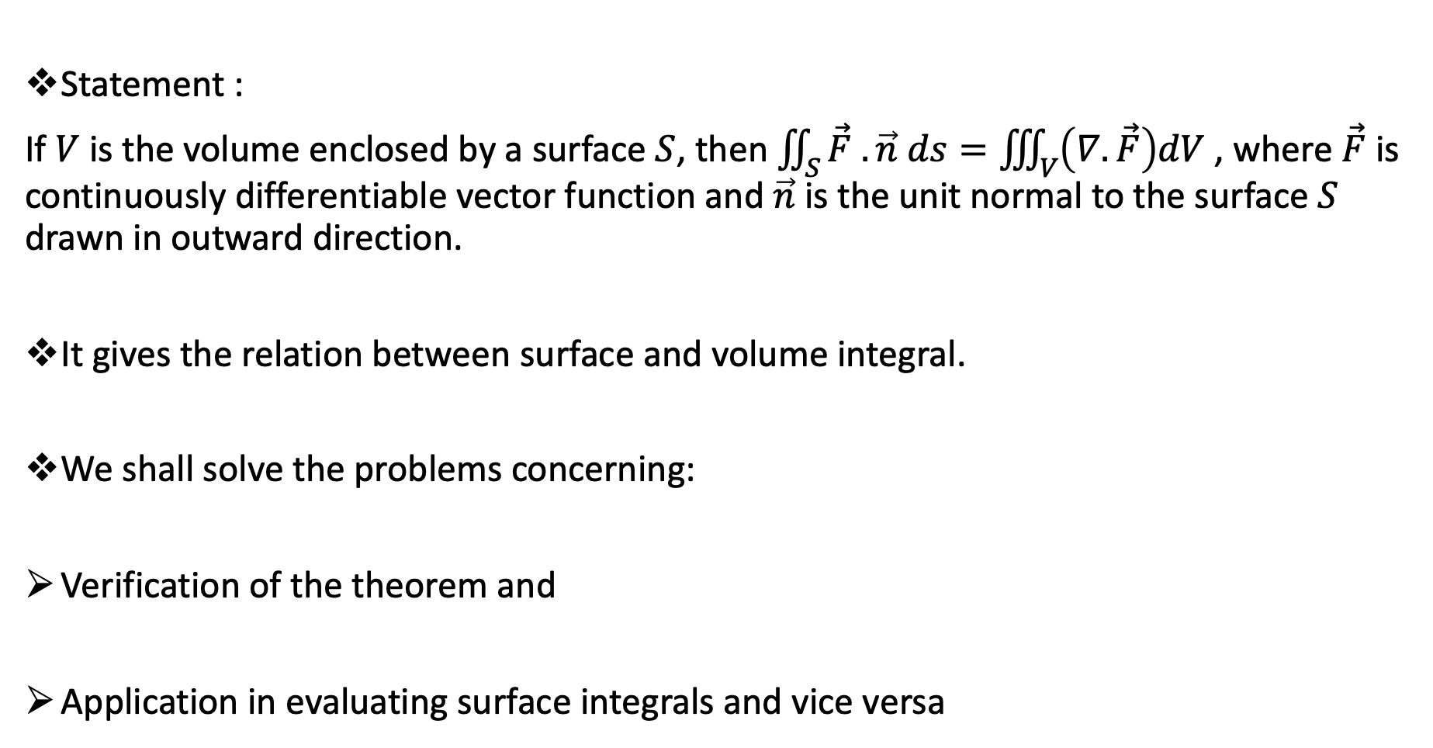
GAUSS’ DIVRGENCE THEOEREM
Statement :
If $V$ is the volume enclosed by a surface $S$, then $\iint_{S}{\vec{F} .\vec{n} ds}=\iiint_{V}{\left(∇.\vec{F}\right)dV}$ , where $\vec{F}$ is continuously differentiable vector function and $\vec{n}$ is the unit normal to the surface $S$ drawn in outward direction.
It gives the relation between surface and volume integral.
We shall solve the problems concerning:
Verification of the theorem and
Application in evaluating surface integrals and vice versa

Slide 2

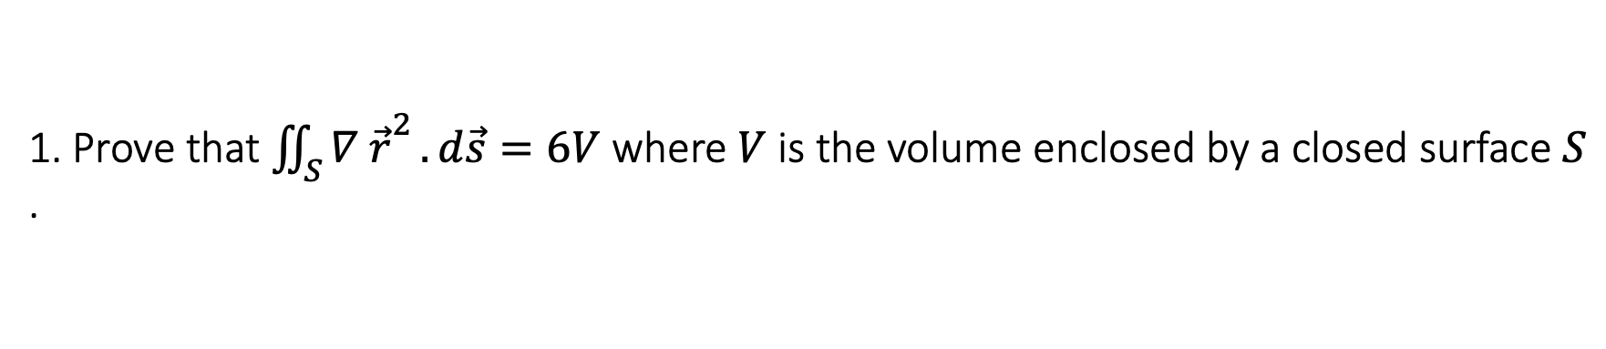
1. Prove that ${\iint_{S}{∇ \vec{r}}}^{2}.d\vec{s}=6V$ where $V$ is the volume enclosed by a closed surface $S$ .
Solution: Here, we know , $\vec{r}=x\vec{i}+y\vec{j}+z\vec{k}$
${\vec{r}}^{2}=\vec{r}.\vec{r}=\left(x\vec{i}+y\vec{j}+z\vec{k} \right).\left(x\vec{i}+y\vec{j}+z\vec{k} \right)$ = $\left(x^{2}+y^{2}+z^{2}\right)$
$\vec{F}=∇ {\vec{r}}^{2}$ = $\left(\vec{i}\frac{∂}{∂x}+\vec{j}\frac{∂}{∂y}+\vec{k}\frac{∂}{∂z}\right) \left(x^{2}+y^{2}+z^{2}\right)$
$∴\vec{F}=2x \vec{i}+2y \vec{j}+2z \vec{k}$
${\iint_{S}{∇ \vec{r}}}^{2}.d\vec{s}=\iint_{S}{\vec{F} . d\vec{s} }$
$=\iiint_{V}{\left(∇.\vec{F}\right)dV}$

Slide 3

= $\iiint_{V}{\left(\vec{i}\frac{∂}{∂x}+\vec{j}\frac{∂}{∂y}+\vec{k}\frac{∂}{∂z}\right). \left(2x \vec{i}+2y \vec{j}+2z \vec{k} \right)dV}$
= $\iiint_{V}{\left(2+2+2\right)dV}$
= $6\iiint_{V}{dV}$
= $6V$

Slide 4
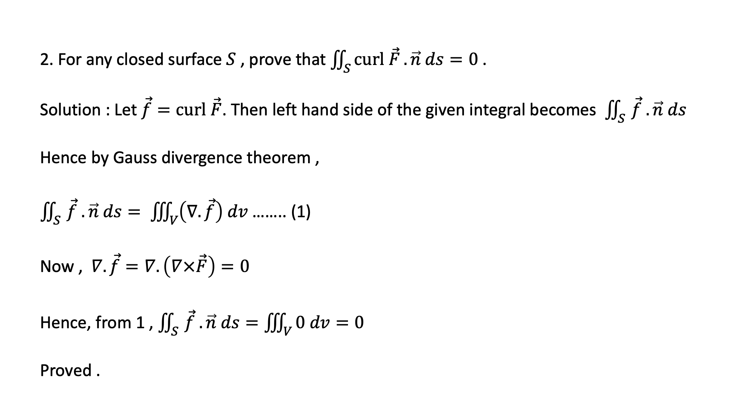
2. For any closed surface $S$ , prove that $\iint_{S}{curl \vec{F}}. \vec{n} ds=0$ .
Solution : Let $\vec{f}=curl \vec{F}$. Then left hand side of the given integral becomes$\iint_{S }{\vec{f} .\vec{n} ds}$
Hence by Gauss divergence theorem ,
$\iint_{S }{\vec{f} .\vec{n} ds}= \iiint_{V}{\left(∇. \vec{f}\right) dv}$ …….. (1)
Now , $∇.\vec{f}=∇. \left(∇×\vec{F}\right)=0$
Hence, from 1 , $\iint_{S }{\vec{f} .\vec{n} ds}=\iiint_{V}{0 dv}=0$
Proved .

Slide 5
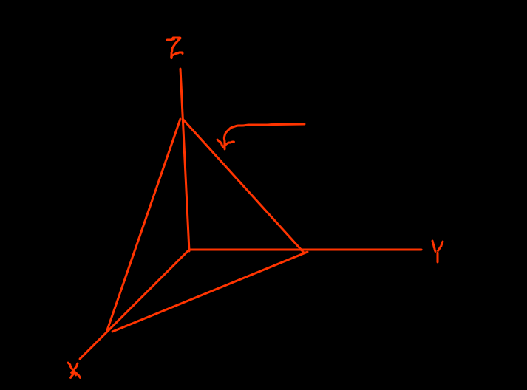

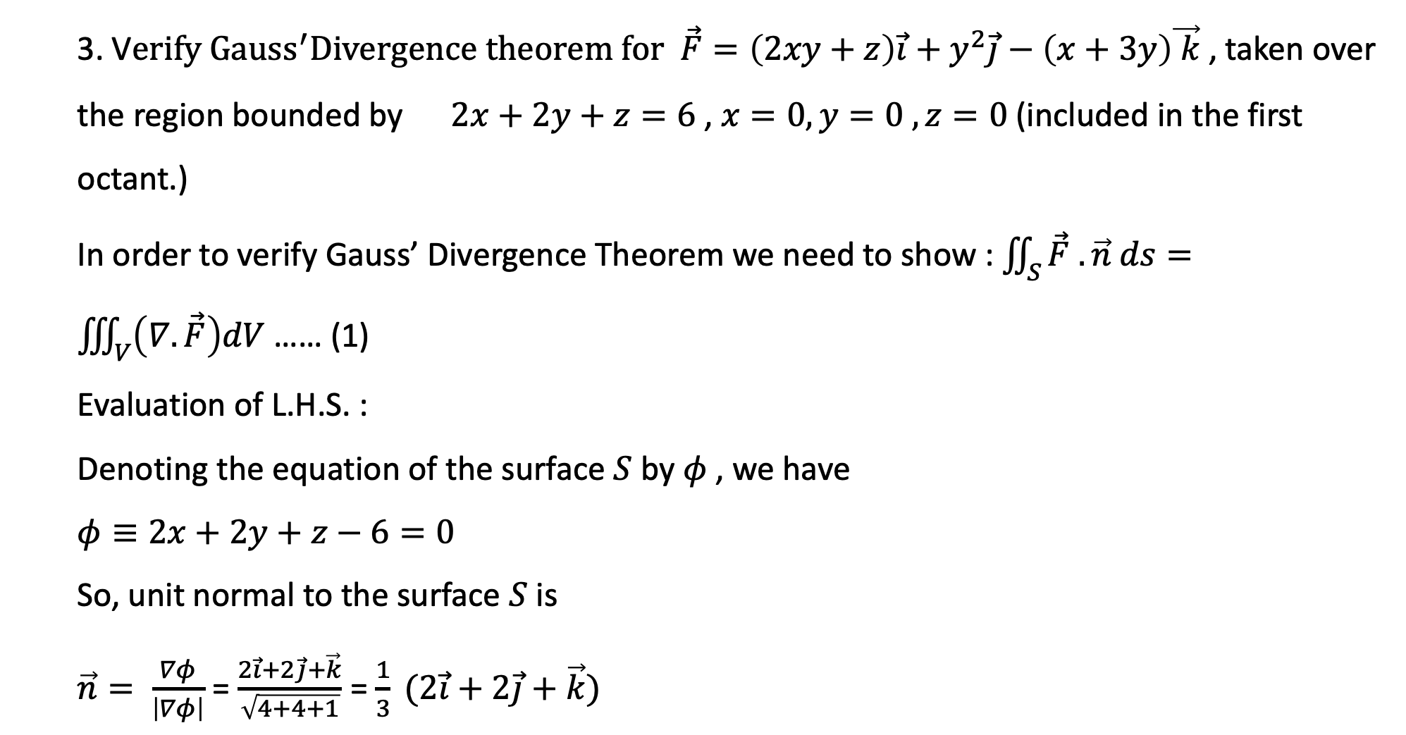



3. V$erify {Gauss}^{′}Divergence theorem for \vec{F}=\left(2xy+z\right)\vec{i}+y^{2}\vec{j}−\left(x+3y\right)\vec{ k}$, taken over the region bounded by $2x+2y+z=6$ , $x=0, y=0 , z=0$ (included in the first octant.)
In order to verify Gauss’ Divergence Theorem we need to show : $\iint_{S}{\vec{F} .\vec{n} ds}=\iiint_{V}{\left(∇.\vec{F}\right)dV}$ …… (1)
Evaluation of L.H.S. :
Denoting the equation of the surface $S$ by $φ$ , we have
$φ≡2x+2y+z−6=0$
So, unit normal to the surface $S$ is
$\vec{n}= \frac{∇φ}{\left|∇φ\right|}$ = $\frac{2\vec{i}+2\vec{j}+\vec{k}}{\sqrt{4+4+1}}$ = $\frac{1}{3} (2\vec{i}+2\vec{j}+\vec{k})$
$$2x+2y+z=6$$
$$2x+z=6$$
$$2y+z=6$$
$$x+y=3$$

Slide 6
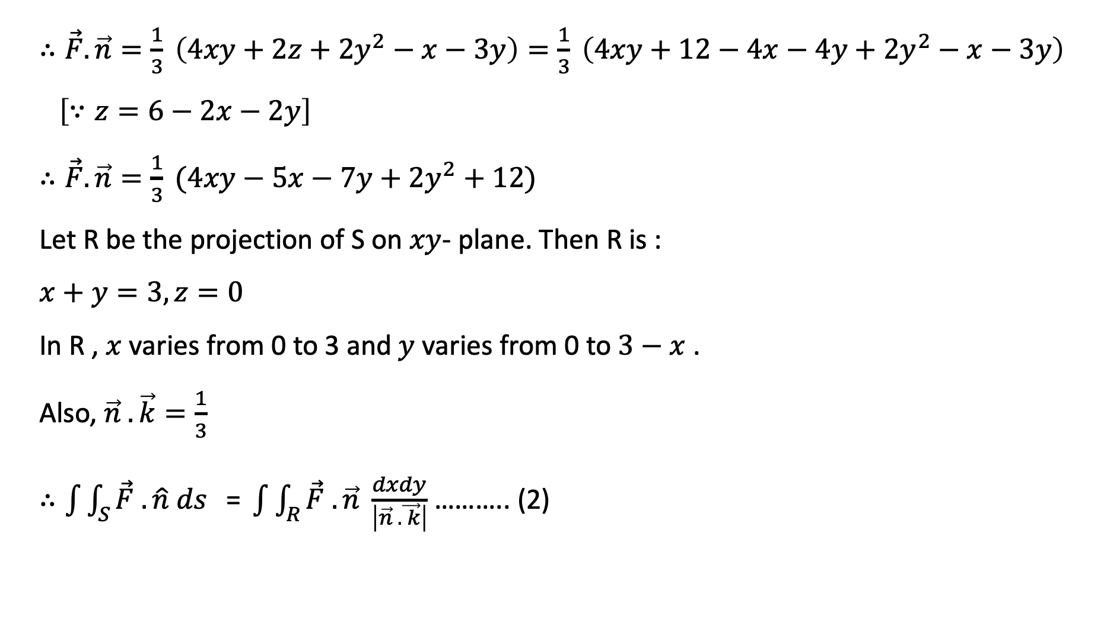
$∴\vec{F}.\vec{n}=\frac{1}{3} \left(4xy+2z+{2y}^{2}−x−3y\right)=\frac{1}{3} \left(4xy+12−4x−4y+{2y}^{2}−x−3y\right)$ $\left[∵z=6−2x−2y\right]$
$∴\vec{F}.\vec{n}=\frac{1}{3} (4xy−5x−7y+2y^{2}+12)$
Let R be the projection of S on $xy$- plane. Then R is :
$x+y=3, z=0$
In R , $x$ varies from 0 to 3 and $y$ varies from 0 to $3−x$ .
Also, $\vec{n} . \vec{k}=\frac{1}{3}$
$∴\int{\int_{S}{\vec{F} . \hat{n} ds}}\text{ = }\int{\int_{R}{\vec{F} . \vec{n} \frac{dxdy}{\left|\vec{n} . \vec{ k}\right|}}}$ ……….. (2)

Slide 7

$\int{\int_{S}{\vec{F} . \vec{n} ds}}=\int{\int_{R}{\frac{1}{3} (4xy−5x−7y+2y^{2}+12) \frac{dxdy}{\frac{1}{3}}}}$
$= \int_{x=0}^{3}{{\left[2xy^{2} −5xy−\frac{7}{2}y^{2}+\frac{2}{3} y^{3}+12y\right]}_{0}^{3−x}} dx$
= $\int_{0}^{3}{\left[ 2x {\left(3−x\right)}^{2} −5x \left(3−x\right)−\frac{7}{2} {\left(3−x\right)}^{2}+\frac{2}{3} {\left(3−x\right)}^{3}+12\left(3−x\right)\right]dx}$

Slide 8
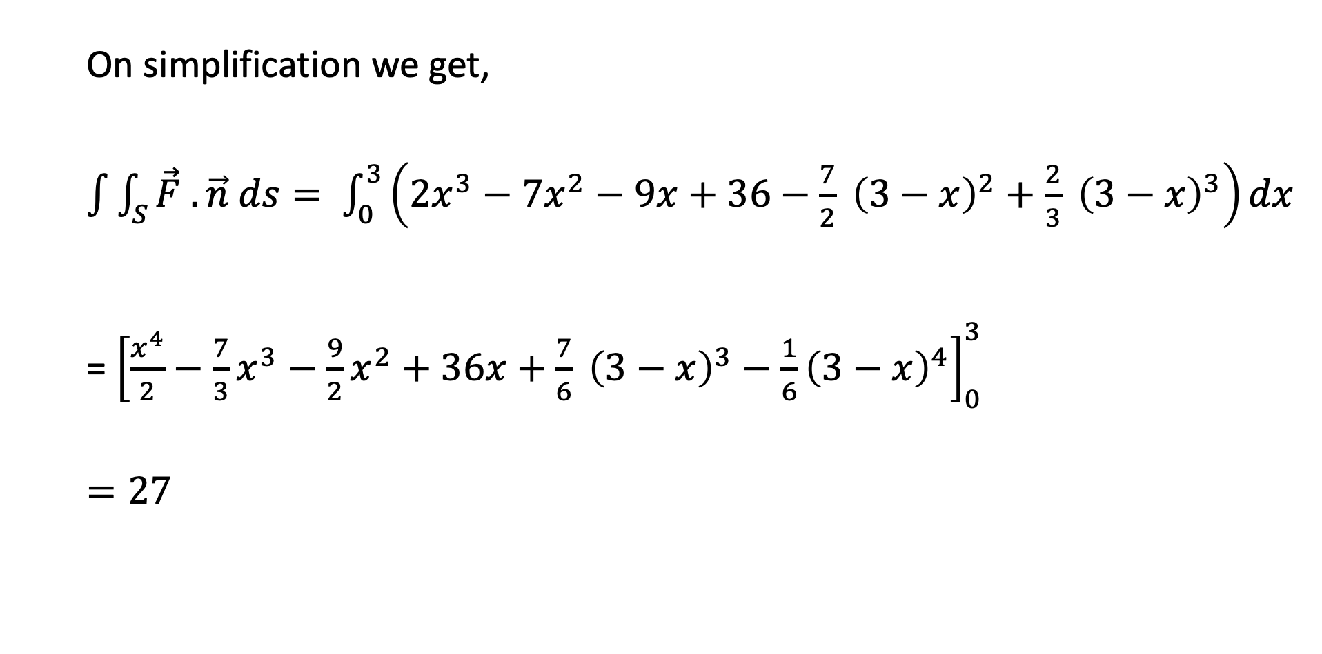
On simplification we get,
$\int{\int_{S}{\vec{F} . \vec{n} ds}}= \int_{0}^{3}{\left(2x^{3}−7x^{2}−9x+36−\frac{7}{2} {\left(3−x\right)}^{2}+\frac{2}{3} {\left(3−x\right)}^{3}\right)dx}$
= ${\left[\frac{x^{4}}{2}−\frac{7}{3}x^{3}−\frac{9}{2}x^{2}+36x+\frac{7}{6} {\left(3−x\right)}^{3}−\frac{1}{6}{\left(3−x\right)}^{4}\right]}_{0}^{3}$
$=27$

Slide 9
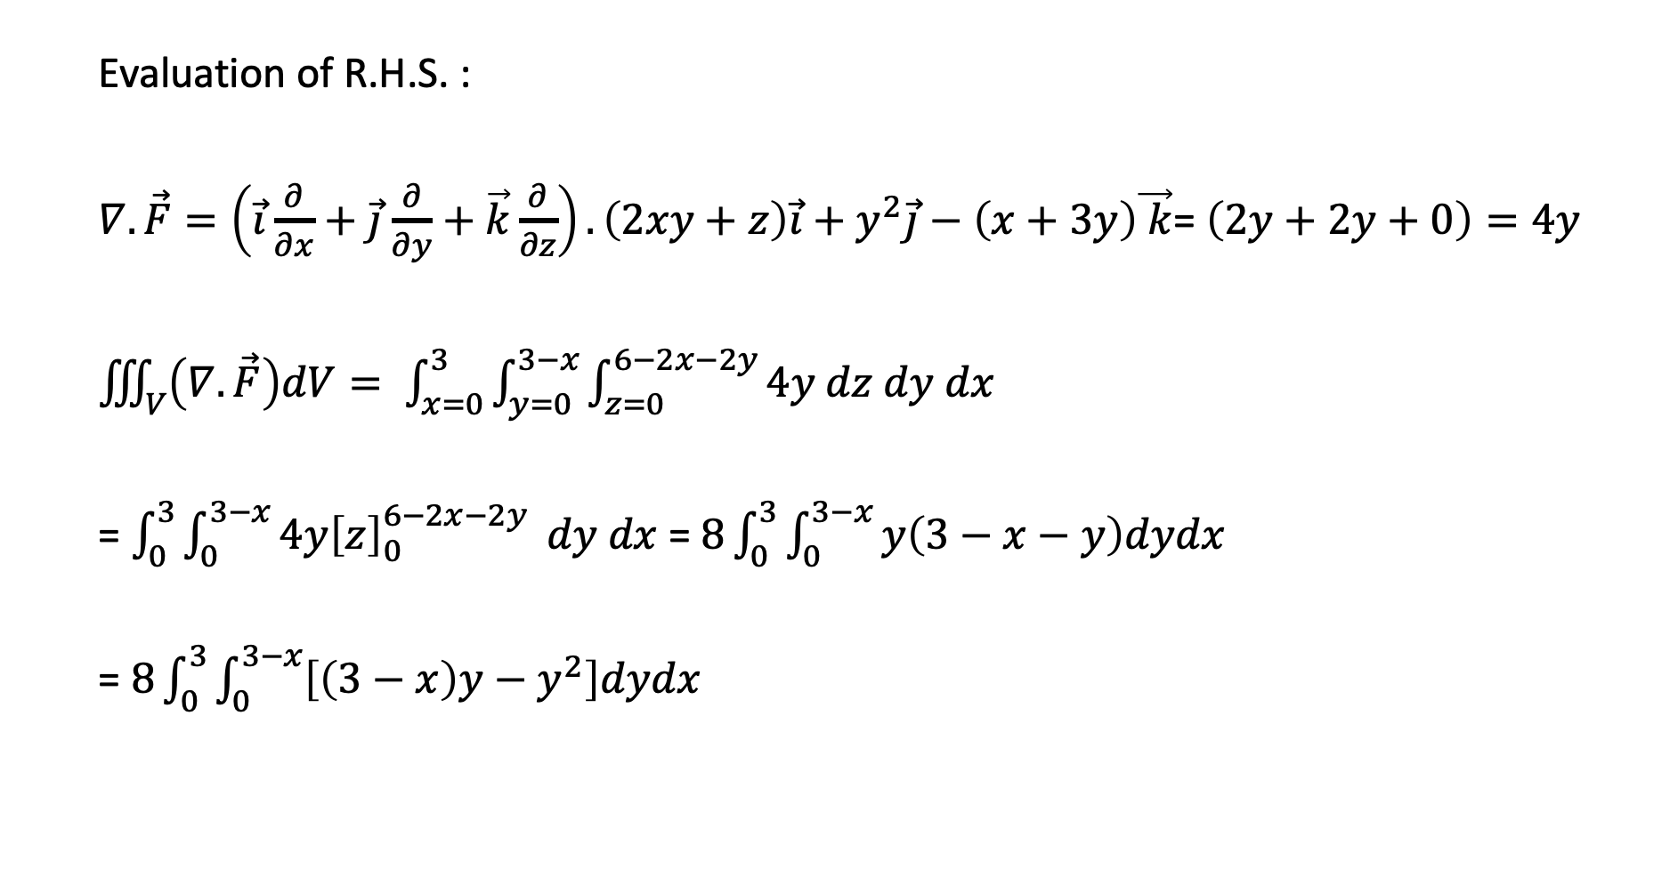
Evaluation of R.H.S. :
$∇.\vec{F}=\left(\vec{i}\frac{∂}{∂x}+\vec{j}\frac{∂}{∂y}+\vec{k}\frac{∂}{∂z}\right).\left(2xy+z\right)\vec{i}+y^{2}\vec{j}−\left(x+3y\right)\vec{ k}$= $\left(2y+2y+0\right)=4y$
$\iiint_{V}{\left(∇.\vec{F}\right)dV}= \int_{x=0}^{3}{\int_{y=0}^{3−x}{\int_{z=0}^{6−2x−2y}{4y dz dy dx}}}$
= $\int_{0}^{3}{\int_{0}^{3−x}{4y{\left[z\right]}_{0}^{6−2x−2y}}} dy dx$ = $8\int_{0}^{3}{\int_{0}^{3−x}{y\left(3−x−y\right)dydx}}$
= $8\int_{0}^{3}{\int_{0}^{3−x}{\left[\left(3−x\right)y−y^{2}\right]dydx}}$

Slide 10
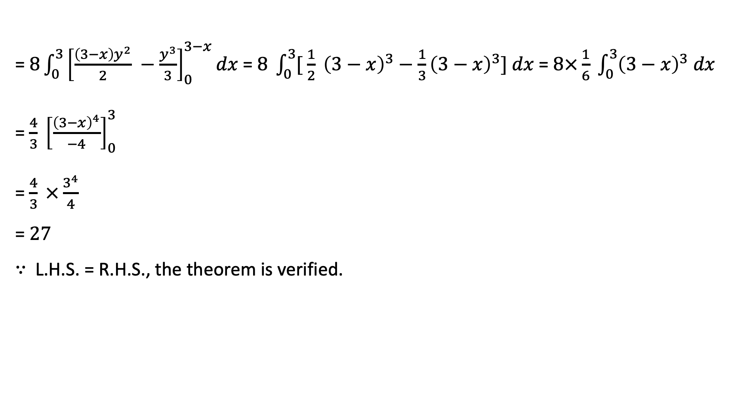
= $8\int_{0}^{3}{{\left[\frac{\left(3−x\right)y^{2}}{2} −\frac{y^{3}}{3}\right]}_{0}^{3−x}dx}$ = $8 \int_{0}^{3}{[ \frac{1}{2}} {\left(3−x\right)}^{3}−\frac{1}{3}{\left(3−x\right)}^{3}] dx$= $8×\frac{1}{6} \int_{0}^{3}{{\left(3−x\right)}^{3} dx}$
= $\frac{4}{3} {\left[\frac{{\left(3−x\right)}^{4}}{−4}\right]}_{0}^{3}$
= $\frac{4}{3} ×\frac{3^{4}}{4}$
= $27$
$∵$ L.H.S. = R.H.S., the theorem is verified.

Slide 11
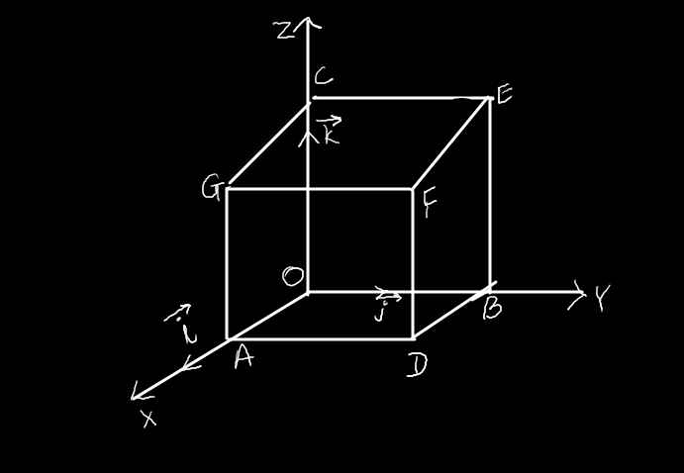
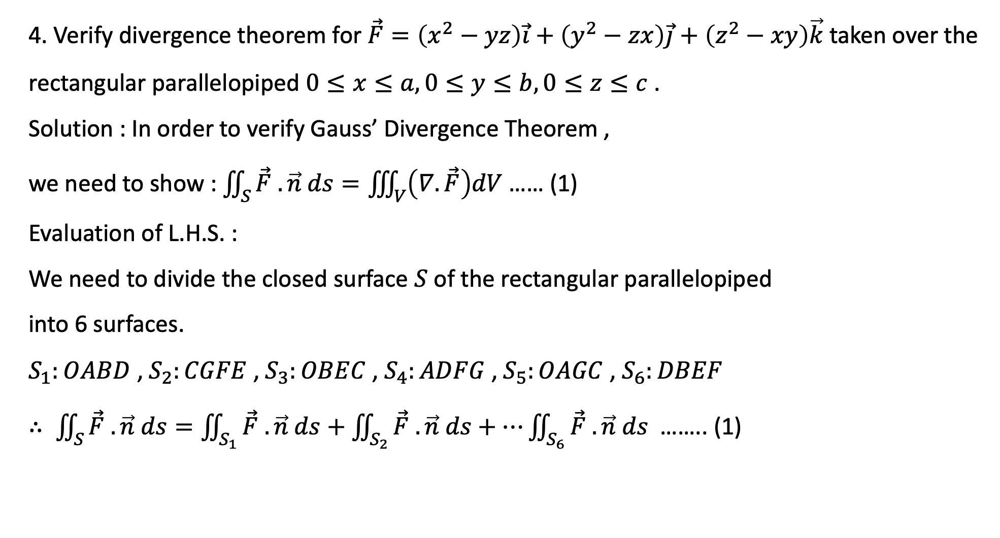
4. Verify divergence theorem for $\vec{F}=\left(x^{2}−yz\right)\vec{i}+\left(y^{2}−zx\right)\vec{j}+\left(z^{2}−xy\right)\vec{k}$taken over the rectangular parallelopiped $0≤x≤a, 0≤y≤b, 0≤z≤c$ .
Solution : In order to verify Gauss’ Divergence Theorem ,
we need to show : $\iint_{S}{\vec{F} .\vec{n} ds}=\iiint_{V}{\left(∇.\vec{F}\right)dV}$ …… (1)
Evaluation of L.H.S. :
We need to divide the closed surface $S$ of the rectangular parallelopiped
into 6 surfaces.
$S_{1}:OABD$ , $S_{2}:CGFE$ , $S_{3}:OBEC$ , $S_{4}:ADFG$ , $S_{5}:OAGC$ , $S_{6}:DBEF$
$∴ \iint_{S}{\vec{F} .\vec{n} ds=\iint_{S_{1}}{\vec{F} .\vec{n} ds+\iint_{S_{2}}{\vec{F} .\vec{n} ds+…\iint_{S_{6}}{\vec{F} .\vec{n} ds }}}}$ …….. (1)

Slide 12
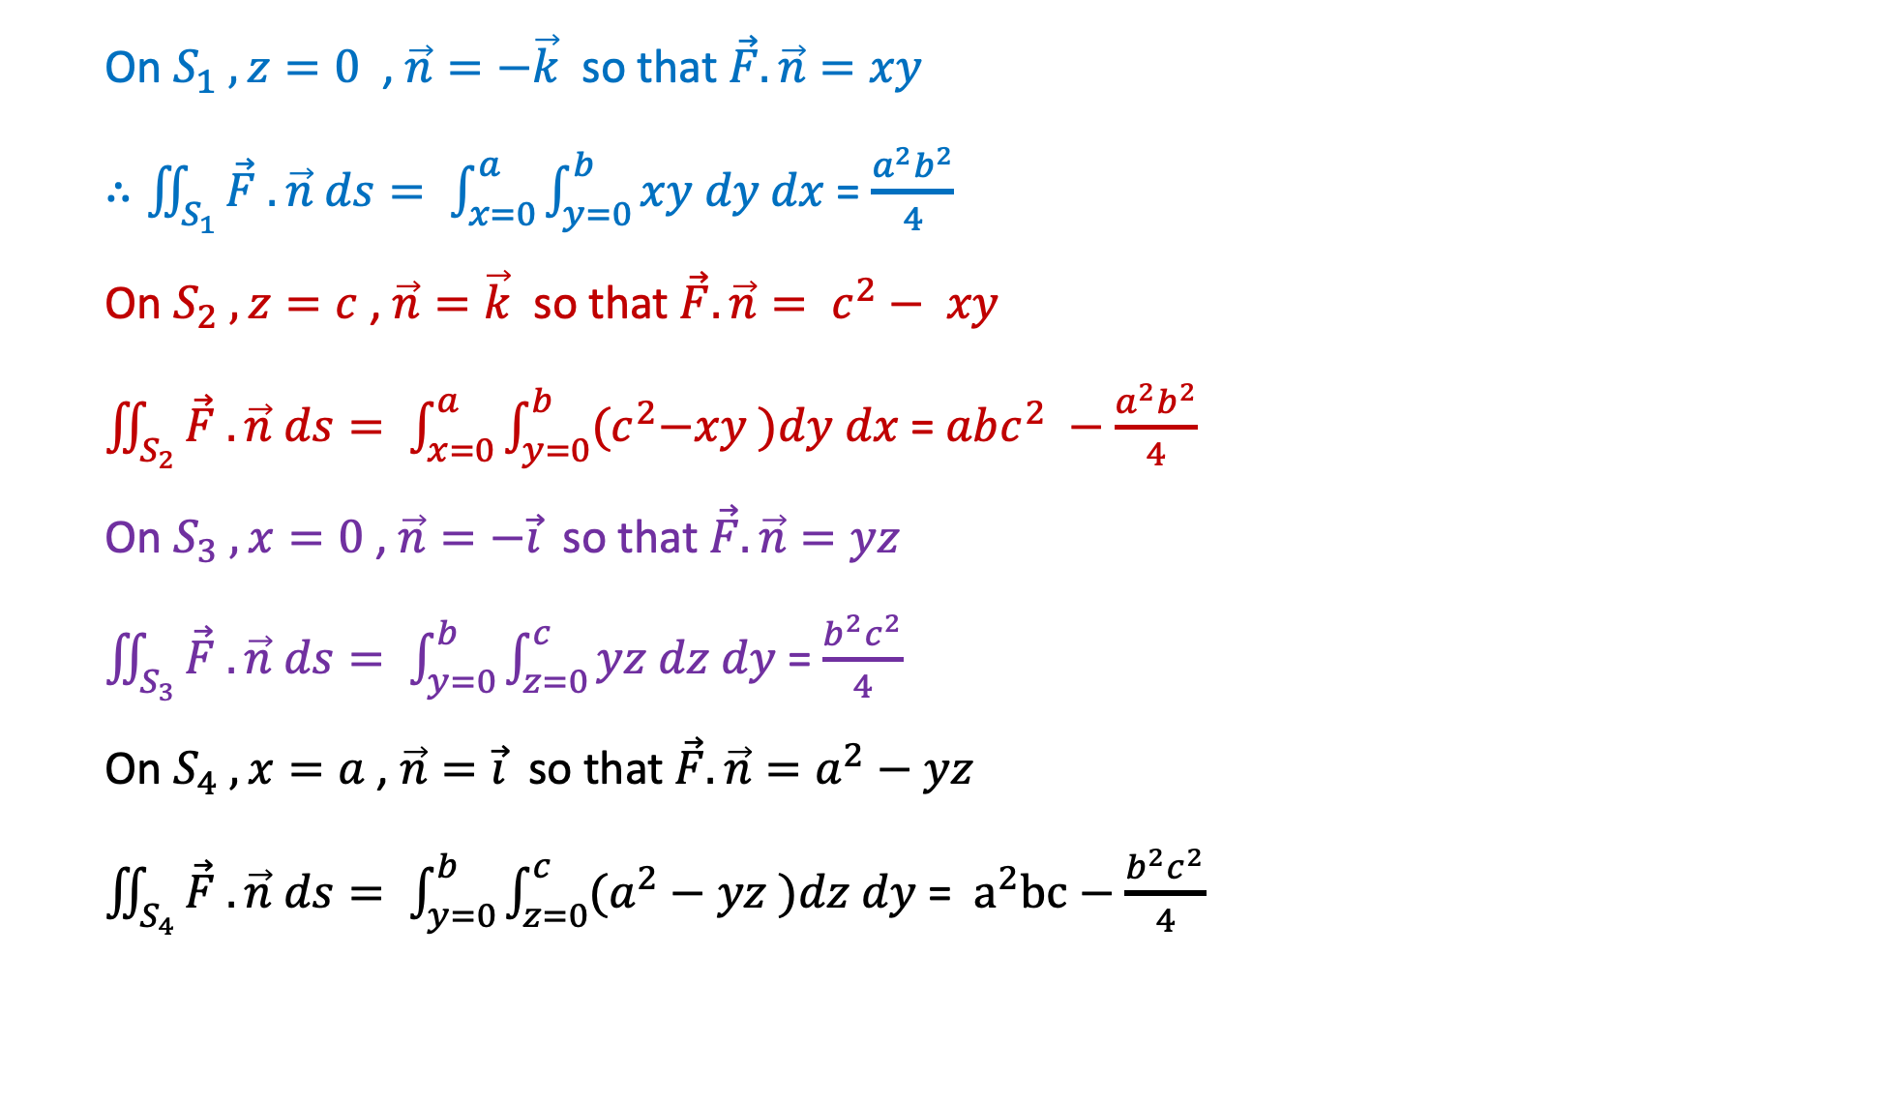

On $S_{1} , z=0$ , $\vec{n}=−\vec{k}$ so that $\vec{F}.\vec{n}=xy$
$∴\iint_{S_{1}}{\vec{F} .\vec{n} ds= \int_{x=0}^{a}{\int_{y=0}^{b}{xy dy dx}}}$ = $\frac{a^{2}b^{2}}{4}$
On $S_{2} , z=c$ , $\vec{n}=\vec{k}$ so that $\vec{F}.\vec{n}= c^{2}− xy$
$\iint_{S_{2}}{\vec{F} .\vec{n} ds= \int_{x=0}^{a}{\int_{y=0}^{b}{{(c}^{2}−xy )dy dx}}}$ = $abc^{2} −\frac{a^{2}b^{2}}{4}$
On $S_{3} , x=0$ , $\vec{n}=−\vec{i}$ so that $\vec{F}.\vec{n}=yz$
$\iint_{S_{3}}{\vec{F} .\vec{n} ds= \int_{y=0}^{b}{\int_{z=0}^{c}{yz dz dy}}}$ = $\frac{b^{2}c^{2}}{4}$
On $S_{4} , x=a$ , $\vec{n}=\vec{i}$ so that $\vec{F}.\vec{n}=a^{2}−yz$
$\iint_{S_{4}}{\vec{F} .\vec{n} ds= \int_{y=0}^{b}{\int_{z=0}^{c}{(a^{2}−yz )dz dy}}}$ = $a^{2}bc−\frac{b^{2}c^{2}}{4}$
$$\vec{F}=\left(x^{2}−yz\right)\vec{i}+\left(y^{2}−zx\right)\vec{j}+\left(z^{2}−xy\right)\vec{k}$$

Slide 13
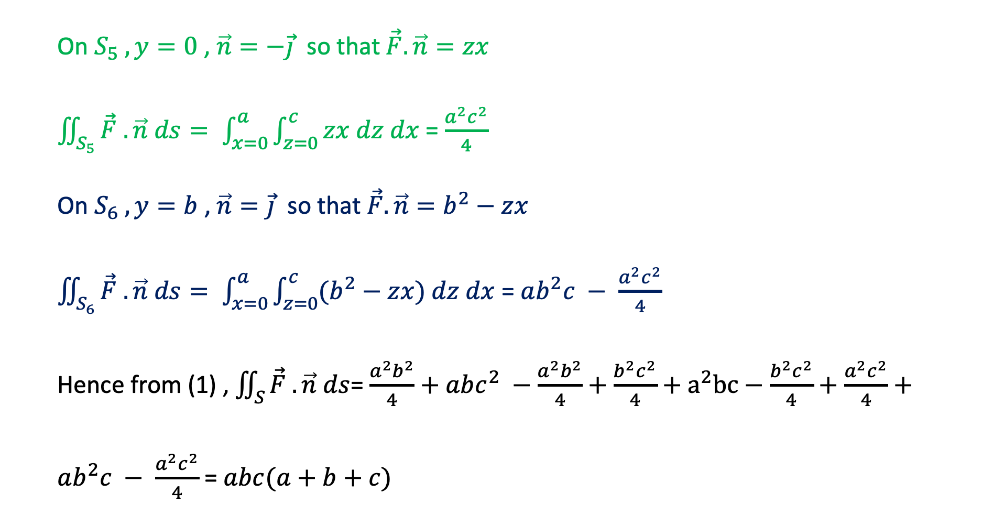

On $S_{5} , y=0$ , $\vec{n}=−\vec{j}$ so that $\vec{F}.\vec{n}=zx$
$\iint_{S_{5}}{\vec{F} .\vec{n} ds= \int_{x=0}^{a}{\int_{z=0}^{c}{zx dz dx}}}$ = $\frac{a^{2}c^{2}}{4}$
On $S_{6} , y=b$ , $\vec{n}=\vec{j}$ so that $\vec{F}.\vec{n}=b^{2}−zx$
$\iint_{S_{6}}{\vec{F} .\vec{n} ds= \int_{x=0}^{a}{\int_{z=0}^{c}{(b^{2}−zx) dz dx}}}$ = $ab^{2}c − \frac{a^{2}c^{2}}{4}$
Hence from (1) , $\iint_{S}{\vec{F} .\vec{n} ds}$= $\frac{a^{2}b^{2}}{4}+$ $abc^{2} −\frac{a^{2}b^{2}}{4}+\frac{b^{2}c^{2}}{4}+a^{2}bc−\frac{b^{2}c^{2}}{4}+\frac{a^{2}c^{2}}{4}+ab^{2}c − \frac{a^{2}c^{2}}{4}$ = $abc(a+b+c)$
$$\vec{F}=\left(x^{2}−yz\right)\vec{i}+\left(y^{2}−zx\right)\vec{j}+\left(z^{2}−xy\right)\vec{k}$$

Slide 14

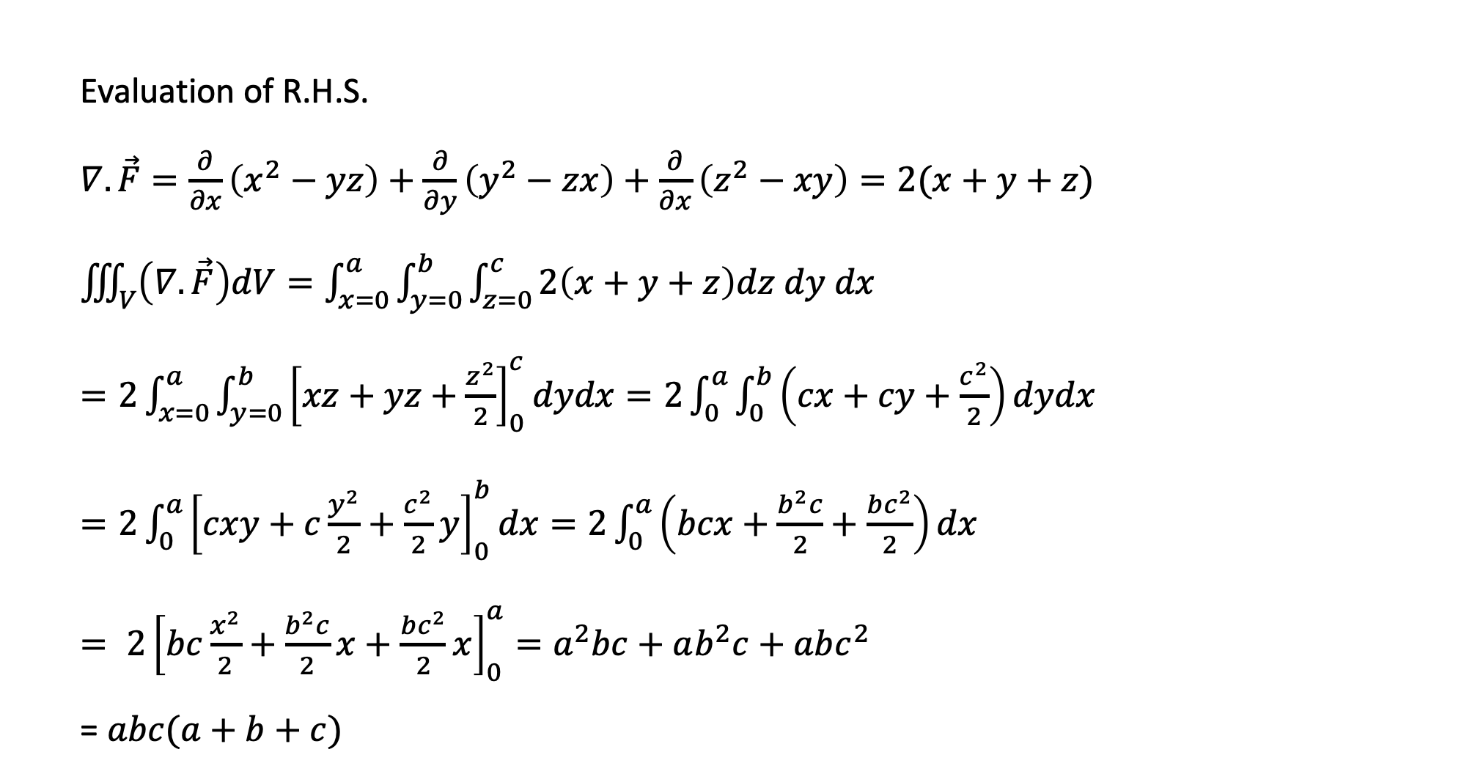
$$\vec{F}=\left(x^{2}−yz\right)\vec{i}+\left(y^{2}−zx\right)\vec{j}+\left(z^{2}−xy\right)\vec{k}$$
Evaluation of R.H.S.
$∇.\vec{F}=\frac{∂}{∂x}\left(x^{2}−yz\right)+\frac{∂}{∂y}\left(y^{2}−zx\right)+\frac{∂}{∂x}\left(z^{2}−xy\right)=2(x+y+z)$
$\iiint_{V}{\left(∇.\vec{F}\right)dV}=\int_{x=0}^{a}{\int_{y=0}^{b}{\int_{z=0}^{c}{2\left(x+y+z\right)dz dy dx}}}$
$=2\int_{x=0}^{a}{\int_{y=0}^{b}{{\left[xz+yz+\frac{z^{2}}{2}\right]}_{0}^{c}}}dydx=2\int_{0}^{a}{\int_{0}^{b}{\left(cx+cy+\frac{c^{2}}{2}\right)dydx}}$
$=2\int_{0}^{a}{{\left[cxy+c\frac{y^{2}}{2}+\frac{c^{2}}{2}y\right]}_{0}^{b}dx=2\int_{0}^{a}{\left(bcx+\frac{b^{2}c}{2}+\frac{bc^{2}}{2}\right)dx}}$
$= {2\left[bc\frac{x^{2}}{2}+\frac{b^{2}c}{2}x+\frac{bc^{2}}{2}x\right]}_{0}^{a}=a^{2}bc+ab^{2}c+abc^{2}$
= $abc(a+b+c)$

Slide 15

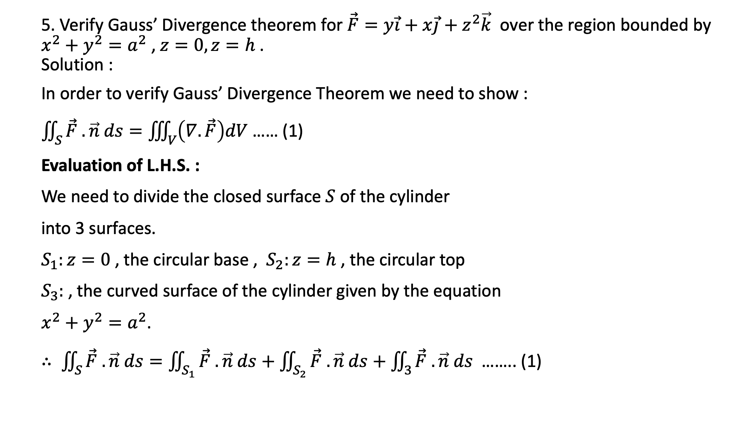
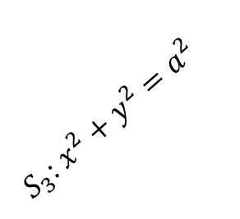

5. Verify Gauss’ Divergence theorem for $\vec{F}=y\vec{i}+x\vec{j}+z^{2}\vec{k}$ over the region bounded by $x^{2}+y^{2}=a^{2}$ , $z=0, z=h$ .
Solution :
In order to verify Gauss’ Divergence Theorem we need to show :
$\iint_{S}{\vec{F} .\vec{n} ds}=\iiint_{V}{\left(∇.\vec{F}\right)dV}$ …… (1)
Evaluation of L.H.S. :
We need to divide the closed surface $S$ of the cylinder
into 3 surfaces.
$S_{1}:z=0$ , the circular base , $S_{2}:z=h$ , the circular top
$S_{3}:$ , the curved surface of the cylinder given by the equation
$x^{2}+y^{2}=a^{2}$.
$∴ \iint_{S}{\vec{F} .\vec{n} ds=\iint_{S_{1}}{\vec{F} .\vec{n} ds+\iint_{S_{2}}{\vec{F} .\vec{n} ds+\iint_{3}{\vec{F} .\vec{n} ds }}}}$ …….. (1)
Z
$$S_{2}:z=h$$
$S_{3}$: $x^{2}+y^{2}=a^{2}$
$$S_{1}:z=0$$
O
Y
X

Slide 16


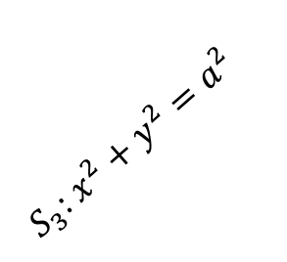

On $S_{1}, z=0$ , $n=−\vec{k}$ . Hence $\vec{F}.\vec{n}=−z^{2}=0$
$∴\iint_{S_{1}}{\vec{F} .\vec{n} ds}=0$
On $S_{2}, z=h$ , $n=\vec{k}$ . Hence $\vec{F}.\vec{n}=z^{2}=h^{2}$
$∴\iint_{S_{2}}{\vec{F} .\vec{n} ds}=\iint_{S_{2}}{h^{2} ds}$
=$h^{2}\iint_{S_{2}}{ ds}$ = $h^{2}×$ area of circle $(x^{2}+y^{2}=a^{2})$
= $πa^{2}h^{2}$
Z
$$S_{2}:z=h$$
$S_{3}$: $x^{2}+y^{2}=a^{2}$
$$S_{1}:z=0$$
O
Y
X

Slide 17
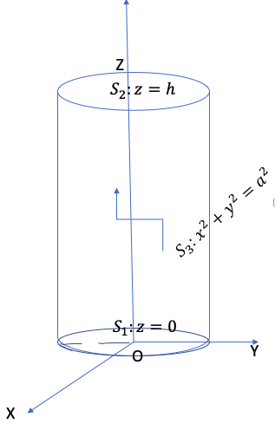
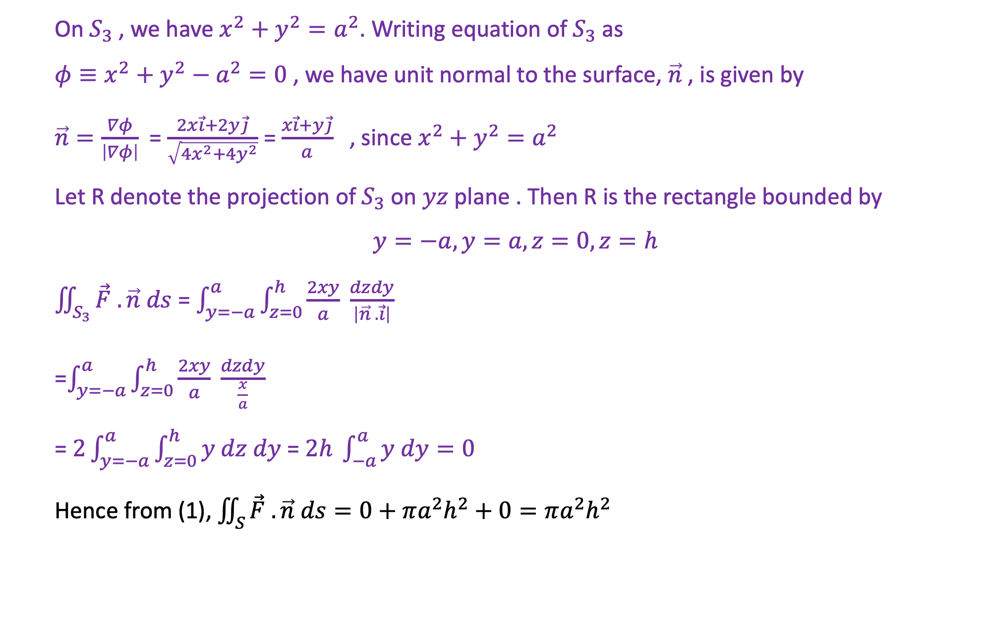

On $S_{3}$ , we have $x^{2}+y^{2}=a^{2}$. Writing equation of $S_{3}$ as
$φ≡x^{2}+y^{2}−a^{2}=0$ , we have unit normal to the surface, $\vec{n}$ , is given by
$\vec{n}=\frac{∇φ}{\left|∇φ\right|}$ = $\frac{2x\vec{i}+2y\vec{j}}{\sqrt{{4x}^{2}+4y^{2}}}$ = $\frac{x\vec{i}+y\vec{j}}{a}$ , since $x^{2}+y^{2}=a^{2}$
Let R denote the projection of $S_{3}$ on $yz$ plane . Then R is the rectangle bounded by
$$y=−a, y=a, z=0,z=h$$
$\iint_{S_{3}}{\vec{F} .\vec{n} ds}$ = $\int_{y=−a}^{a}{\int_{z=0}^{h}{\frac{2xy}{a}}} \frac{dzdy}{\left|\vec{n} . \vec{i}\right|}$
=$\int_{y=−a}^{a}{\int_{z=0}^{h}{\frac{2xy}{a}}} \frac{dzdy}{\frac{x}{a}}$
= $2\int_{y=−a}^{a}{\int_{z=0}^{h}{y dz dy }}$= $2h \int_{−a}^{a}{y dy=0}$
Hence from (1), $\iint_{S}{\vec{F} .\vec{n} ds}=0+πa^{2}h^{2}+0=πa^{2}h^{2}$
$$\vec{F}=y\vec{i}+x\vec{j}+z^{2}\vec{k}$$
R

Slide 18
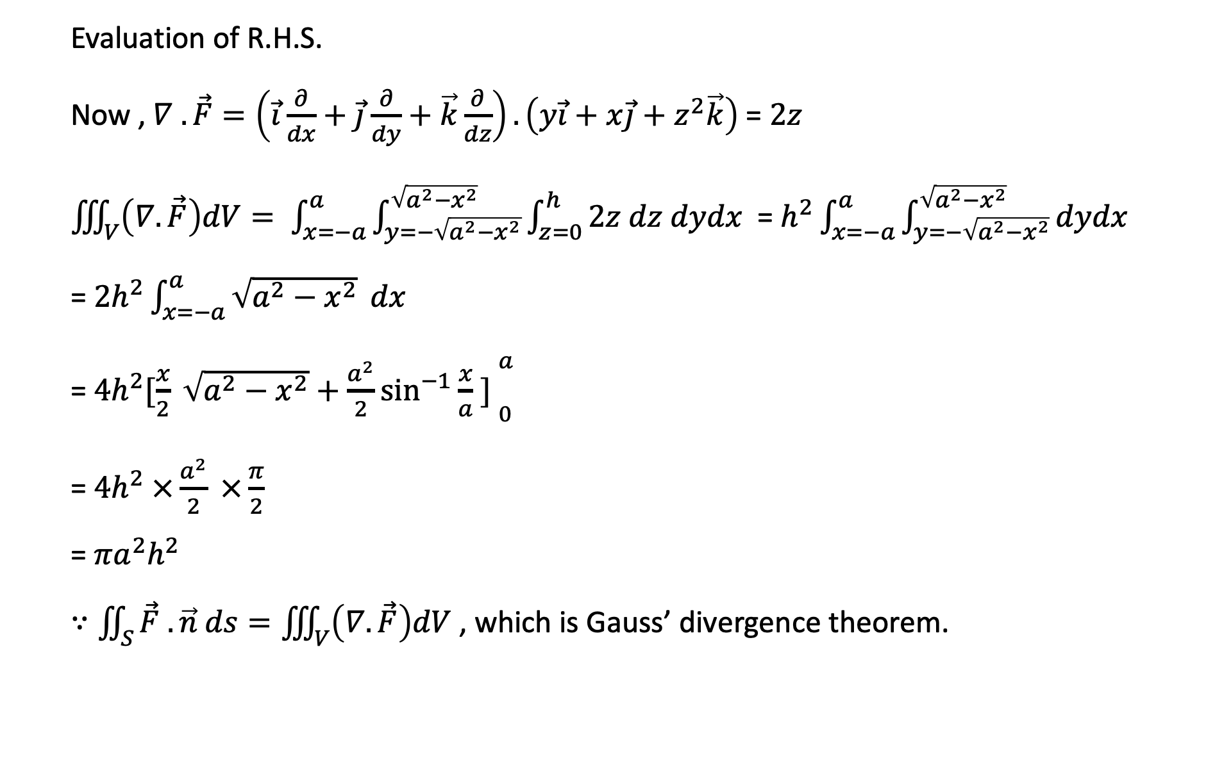
Evaluation of R.H.S.
Now , $∇ .\vec{F}=\left(\vec{i}\frac{∂}{dx}+\vec{j}\frac{∂}{dy}+\vec{k}\frac{∂}{dz}\right).\left(y\vec{i}+x\vec{j}+z^{2}\vec{k}\right)$ = $2z$
$\iiint_{V}{\left(∇.\vec{F}\right)dV}= \int_{x=−a}^{a}{\int_{y=−\sqrt{a^{2}−x^{2}}}^{\sqrt{a^{2}−x^{2}}}{\int_{z=0}^{h}{2z dz dydx}}}$ = $h^{2}\int_{x=−a}^{a}{\int_{y=−\sqrt{a^{2}−x^{2}}}^{\sqrt{a^{2}−x^{2}}}{dydx}}$
= $2h^{2}\int_{x=−a}^{a}{\sqrt{a^{2}−x^{2}}} dx$
= $4h^{2}{[\frac{x}{2} \sqrt{a^{2}−x^{2}}+\frac{a^{2}}{2}\sin^{−1}{\frac{x}{a} ] }}_{0}^{a}$
= $4h^{2} ×\frac{a^{2}}{2} ×\frac{π}{2}$
= $πa^{2}h^{2}$
$∵\iint_{S}{\vec{F} .\vec{n} ds}=\iiint_{V}{\left(∇.\vec{F}\right)dV}$ , which is Gauss’ divergence theorem.

Slide 19
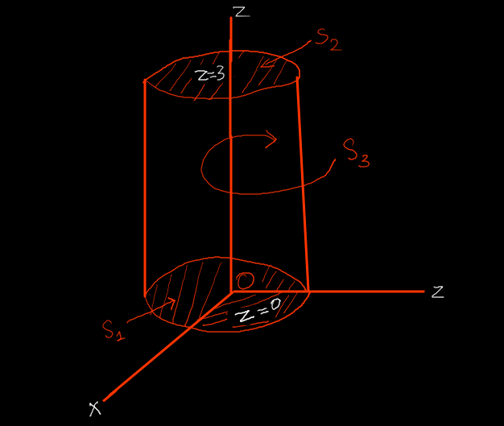
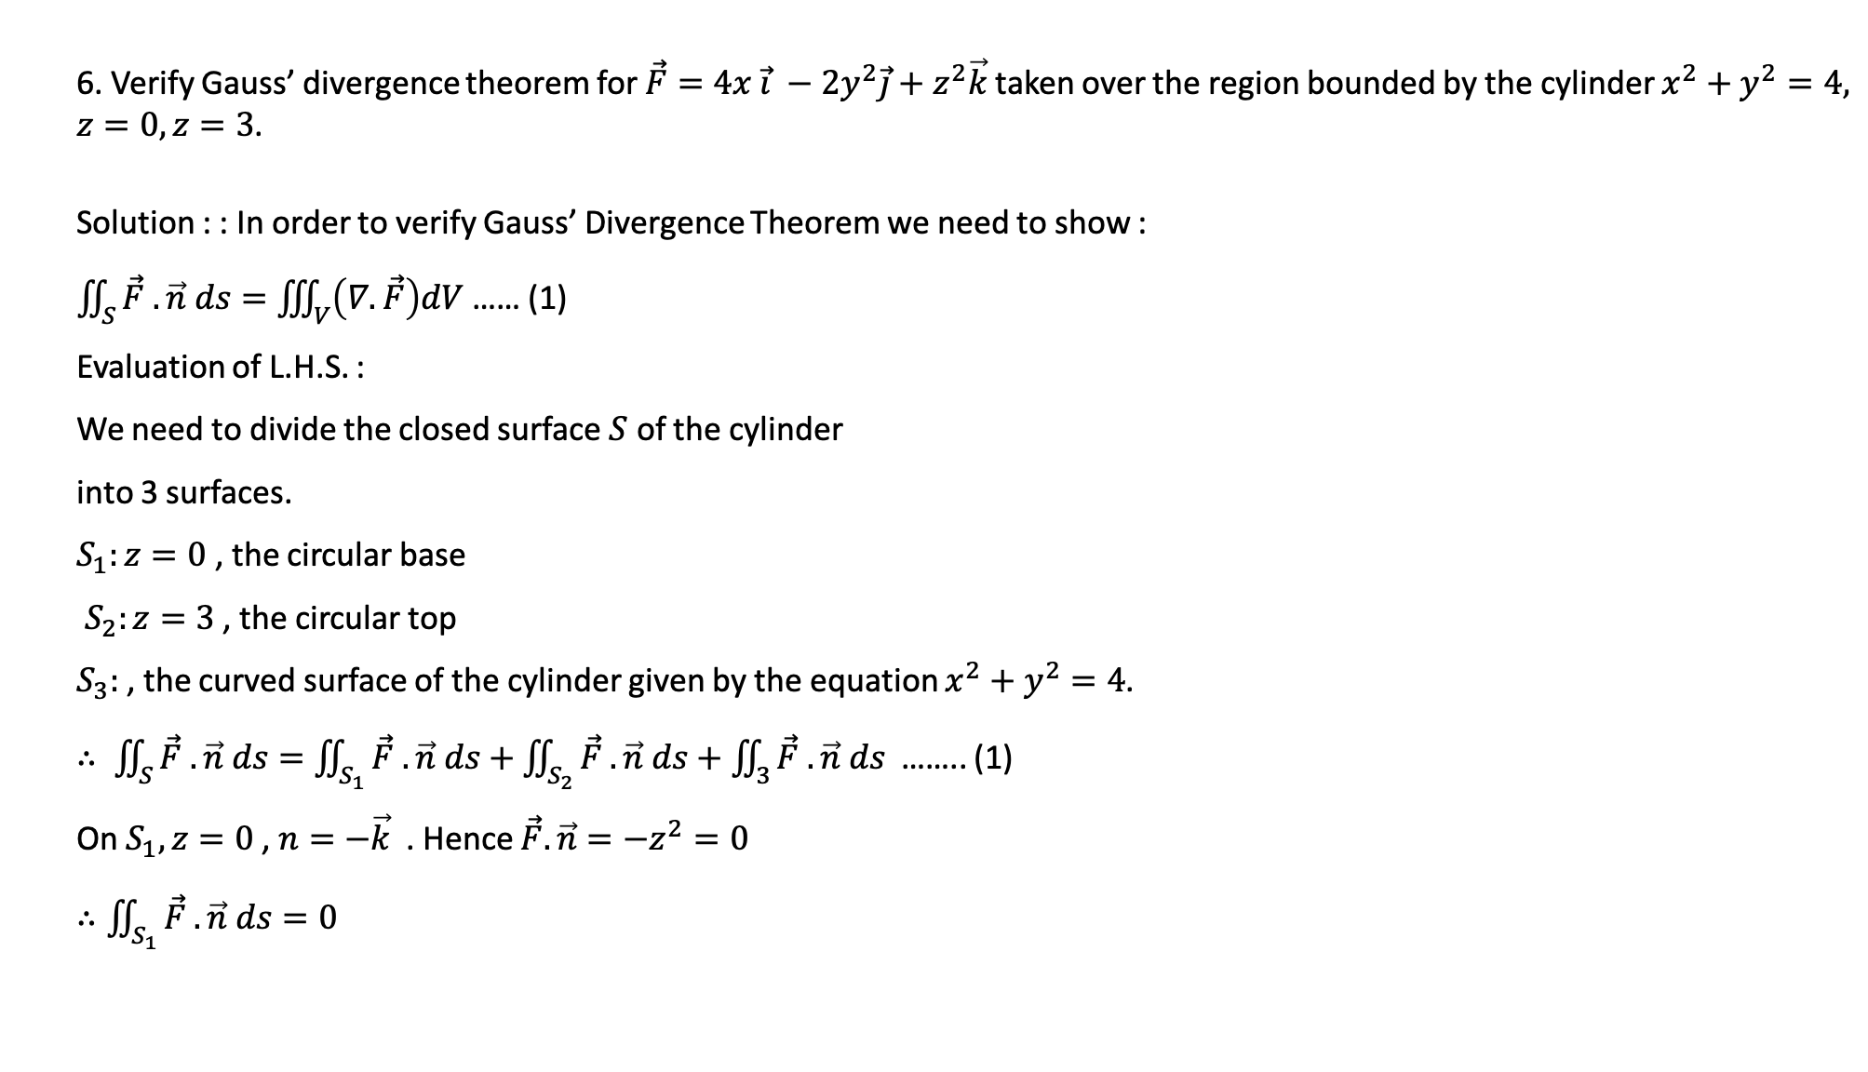
6. Verify Gauss’ divergence theorem for $\vec{F}=4x \vec{i} −2y^{2}\vec{j}+z^{2}\vec{k}$taken over the region bounded by the cylinder $x^{2}+y^{2}=4,$ $z=0, z=3$.
Solution : : In order to verify Gauss’ Divergence Theorem we need to show :
$\iint_{S}{\vec{F} .\vec{n} ds}=\iiint_{V}{\left(∇.\vec{F}\right)dV}$ …… (1)
Evaluation of L.H.S. :
We need to divide the closed surface $S$ of the cylinder
into 3 surfaces.
$S_{1}:z=0$ , the circular base
$S_{2}:z=3$ , the circular top
$S_{3}:$ , the curved surface of the cylinder given by the equation $x^{2}+y^{2}=4$.
$∴ \iint_{S}{\vec{F} .\vec{n} ds=\iint_{S_{1}}{\vec{F} .\vec{n} ds+\iint_{S_{2}}{\vec{F} .\vec{n} ds+\iint_{3}{\vec{F} .\vec{n} ds }}}}$ …….. (1)
On $S_{1}, z=0$ , $n=−\vec{k}$ . Hence $\vec{F}.\vec{n}=−z^{2}=0$
$∴\iint_{S_{1}}{\vec{F} .\vec{n} ds}=0$

Slide 20
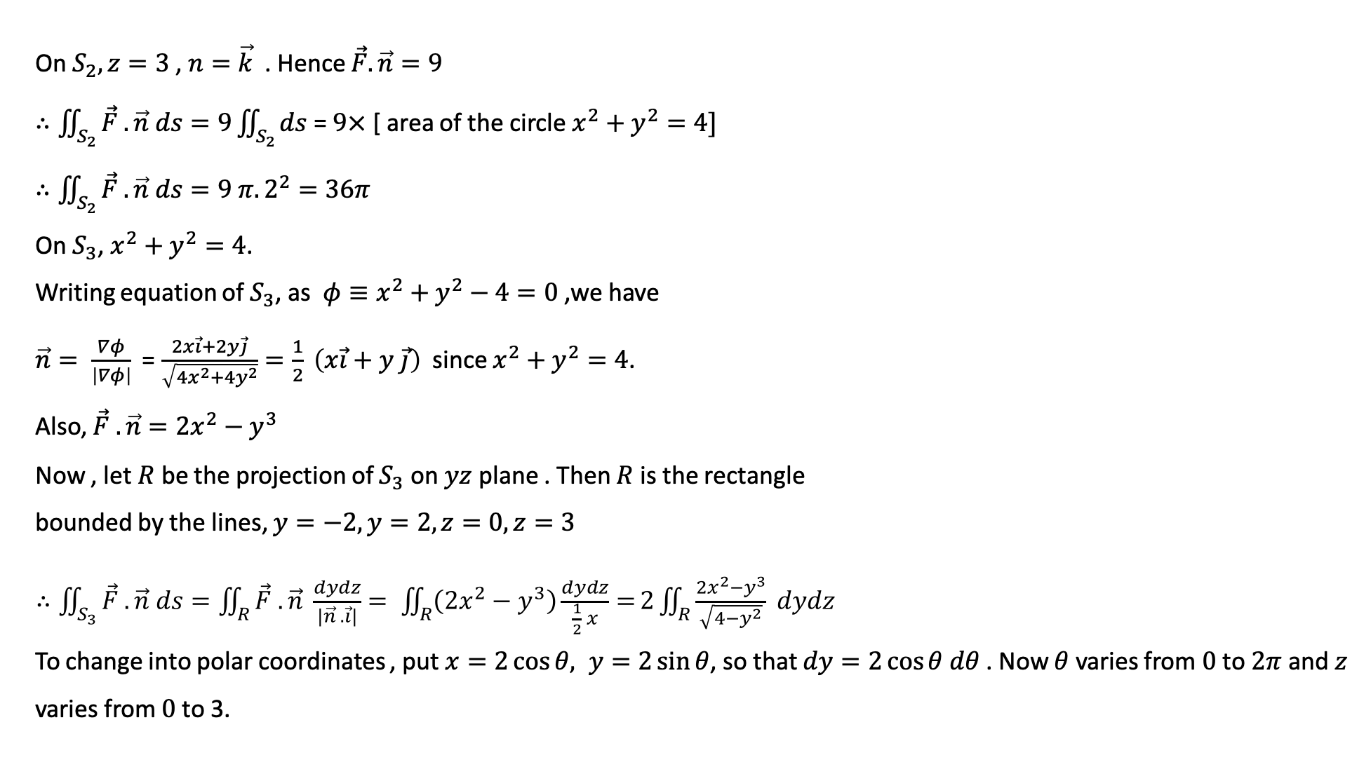
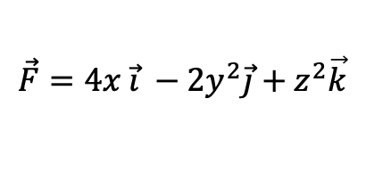
On $S_{2}, z=3$ , $n=\vec{k}$ . Hence $\vec{F}.\vec{n}=9$
$∴\iint_{S_{2}}{\vec{F} .\vec{n} ds}=9\iint_{S_{2}}{ds}$ = $9×$ [ area of the circle $x^{2}+y^{2}=4]$
$∴\iint_{S_{2}}{\vec{F} .\vec{n} ds}=9 π. 2^{2}=36π$
On $S_{3}$, $x^{2}+y^{2}=4$.
Writing equation of $S_{3}$, as ${φ≡x}^{2}+y^{2}−4=0$,we have
$\vec{n}= \frac{∇φ}{\left|∇φ\right|}$ = $\frac{2x\vec{i}+2y\vec{j}}{\sqrt{4x^{2}+4y^{2}}}=\frac{1}{2} \left(x\vec{i}+y \vec{j}\right)$ since $x^{2}+y^{2}=4$.
Also, $\vec{F} .\vec{n}=2x^{2}−y^{3}$
Now , let $R$ be the projection of $S_{3}$ on $yz$ plane . Then $R$ is the rectangle
bounded by the lines, $y=−2, y=2, z=0, z=3$
$∴\iint_{S_{3}}{\vec{F} .\vec{n} ds}=\iint_{R}{\vec{F} .\vec{n} \frac{dydz}{\left|\vec{n} . \vec{i}\right|}}= \iint_{R}{\left(2x^{2}−y^{3}\right)\frac{dydz}{\frac{1}{2} x}=}2\iint_{R}{\frac{2x^{2}−y^{3}}{\sqrt{4−y^{2}}} dydz}$
To change into polar coordinates , put $x=2\cos{θ, y=2\sin{θ}}$, so that $dy=2\cos{θ dθ}$ . Now $θ$ varies from $0$ to $2π$ and $z$
varies from $0$to 3.
$$\vec{F}=4x \vec{i} −2y^{2}\vec{j}+z^{2}\vec{k}$$

Slide 21
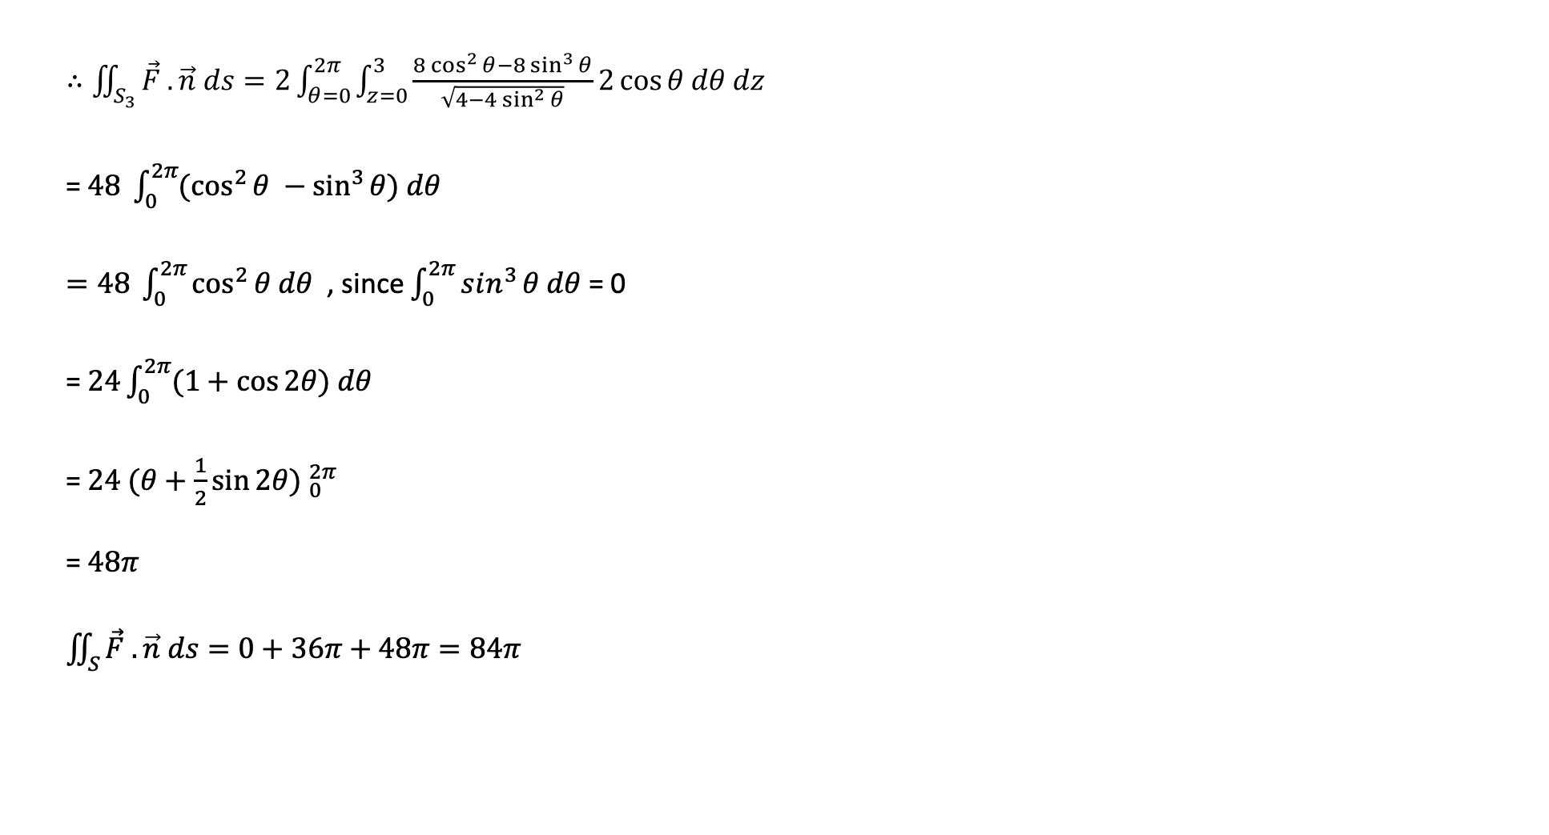
$∴\iint_{S_{3}}{\vec{F} .\vec{n} ds}=2\int_{θ=0}^{2π}{\int_{z=0}^{3}{\frac{8\cos^{2}{θ}−8\sin^{3}{θ}}{\sqrt{4−4\sin^{2}{θ}}}2\cos{θ dθ dz}}}$
= $48 \int_{0}^{2π}{(\cos^{2}{θ −\sin^{3}{θ) dθ}}}$
$=48 \int_{0}^{2π}{\cos^{2}{θ dθ}}$ , since $\int_{0}^{2π}{sin^{3}{θ dθ}}$ = 0
= $24\int_{0}^{2π}{(1+\cos{2θ) dθ}}$
= $24 {(θ+\frac{1}{2}\sin{2θ) }}_{0}^{2π}$
= $48π$
$\iint_{S}{\vec{F} .\vec{n} ds}=0+36π+48π=84π$

Slide 22

Evaluation of R.H.S.
$\left(∇.\vec{F}\right)=\frac{∂}{∂x}\left(4x\right)+\frac{∂}{∂y}\left({−2y}^{2}\right)+\frac{∂}{∂x}\left(z^{2}\right)=4−4y+2z$
$\iiint_{V}{\left(∇.\vec{F}\right)dV}=\int_{z=0}^{3}{\int_{x=−2}^{2}{\int_{y=−\sqrt{4−x^{2}}}^{\sqrt{4−x^{2}}}{(4−4y+2z) dy dx}}}dz$
= $2\int_{z=0}^{3}{\int_{x=−2}^{2}{\int_{y=0}^{\sqrt{4−x^{2}}}{(4+2z) dy dx}}}dz$ , since $\int_{y=−\sqrt{4−x^{2}}}^{\sqrt{4−x^{2}}}{ydy=0}$
= $2\int_{z=0}^{3}{\int_{x=−2}^{2}{(4+2z)}}\sqrt{4−x^{2}} dx dz$
= $4 \int_{z=0}^{3}{(4+2z){[\frac{x}{2} \sqrt{4−x^{2}}+\frac{4}{2}\sin^{−1}{\frac{x}{2}] }}_{0}^{2}} dz$
= $4π \int_{z=0}^{3}{\left(4+2z\right)dz}$ = $4π {\left[4z+z^{2}\right]}_{0}^{3}$
= $84π$

Slide 23
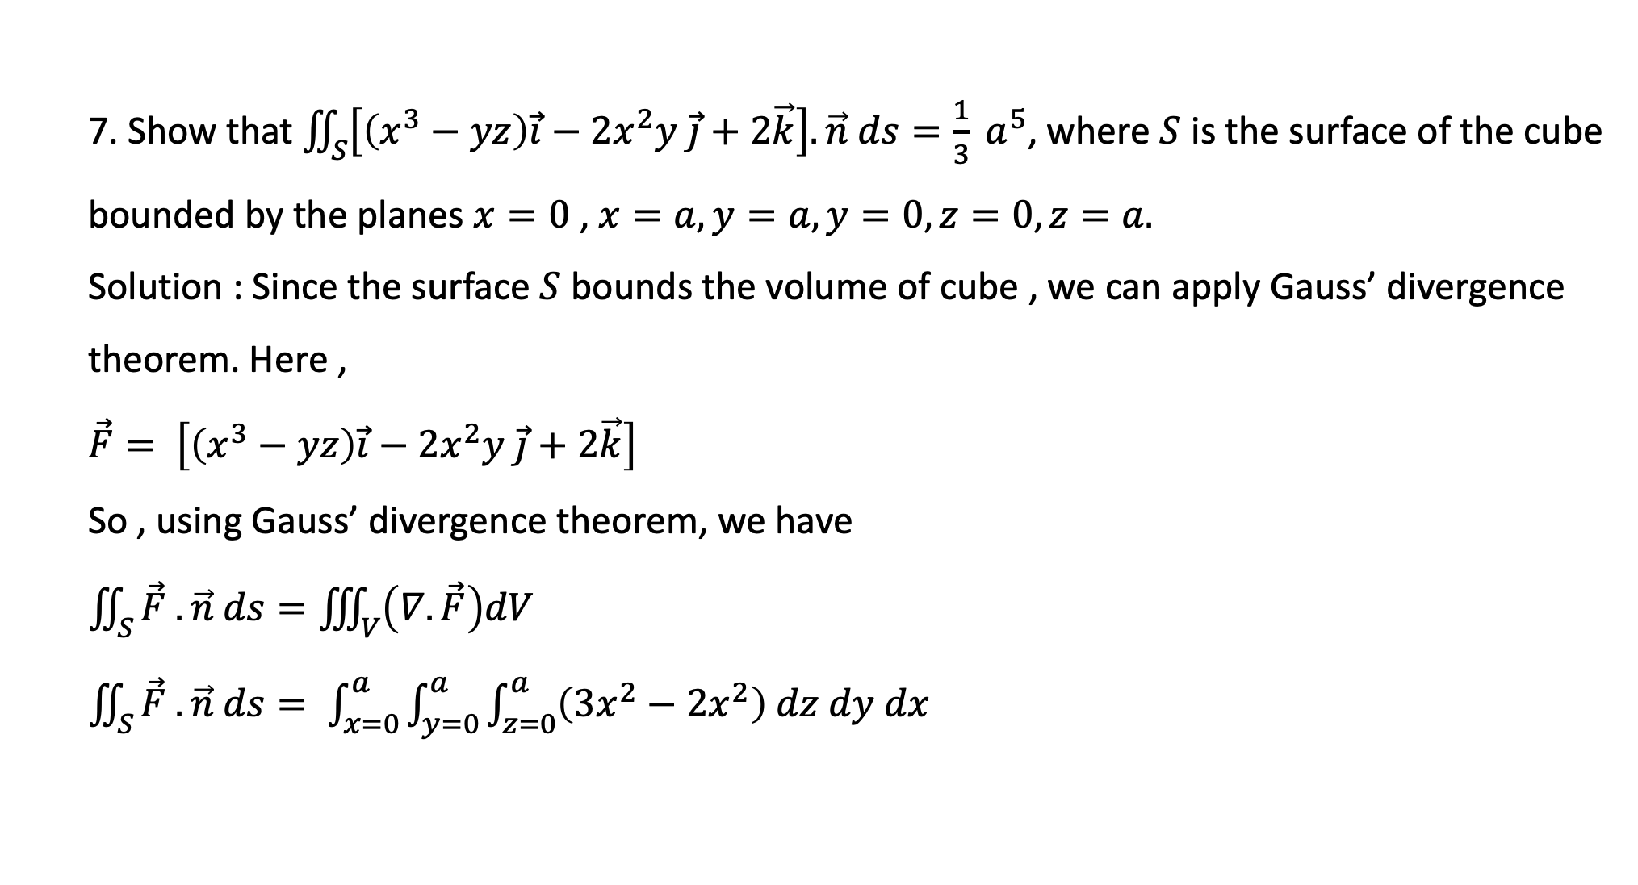
7. Show that $\iint_{S}{\left[\left(x^{3}−yz\right)\vec{i}−2x^{2}y \vec{j}+2\vec{k}\right].\vec{n} ds=\frac{1}{3} a^{5}}$, where $S$ is the surface of the cube bounded by the planes $x=0$ , $x=a, y=a, y=0, z=0, z=a.$
Solution : Since the surface $S$ bounds the volume of cube , we can apply Gauss’ divergence theorem. Here ,
$\vec{F}= \left[\left(x^{3}−yz\right)\vec{i}−2x^{2}y \vec{j}+2\vec{k}\right]$
So , using Gauss’ divergence theorem, we have
$\iint_{S}{\vec{F} .\vec{n} ds}=\iiint_{V}{\left(∇.\vec{F}\right)dV}$
$\iint_{S}{\vec{F} .\vec{n} ds}= \int_{x=0}^{a}{\int_{y=0}^{a}{\int_{z=0}^{a}{\left(3x^{2}−2x^{2}\right) dz dy dx}}}$

Slide 24

$=\int_{x=0}^{a}{\int_{y=0}^{a}{\int_{z=0}^{a}{\left(x^{2}\right) dz dy dx}}}$
= $a \int_{x=0}^{a}{\int_{y=0}^{a}{x^{2}dy dx}}$
= $a^{2} \int_{x=0}^{a}{x^{2}dx}$
= $a^{2}×\frac{a^{3}}{3}$
= $\frac{a^{5}}{3}$ . Proved

